Slide 1

Machine Learning Approach to Predictive Outcome for Sheltered Animals
Jasper Sandhu
SID: 862188200
University of California Riverside
UCR MSOL Data Science
12/03/2021
Notes:
Hello! I’m Jasper Sandhu and I will be presenting my capstone project, “Machine Learning Approach to Predictive Outcome for Sheltered Animals”.

Slide 2

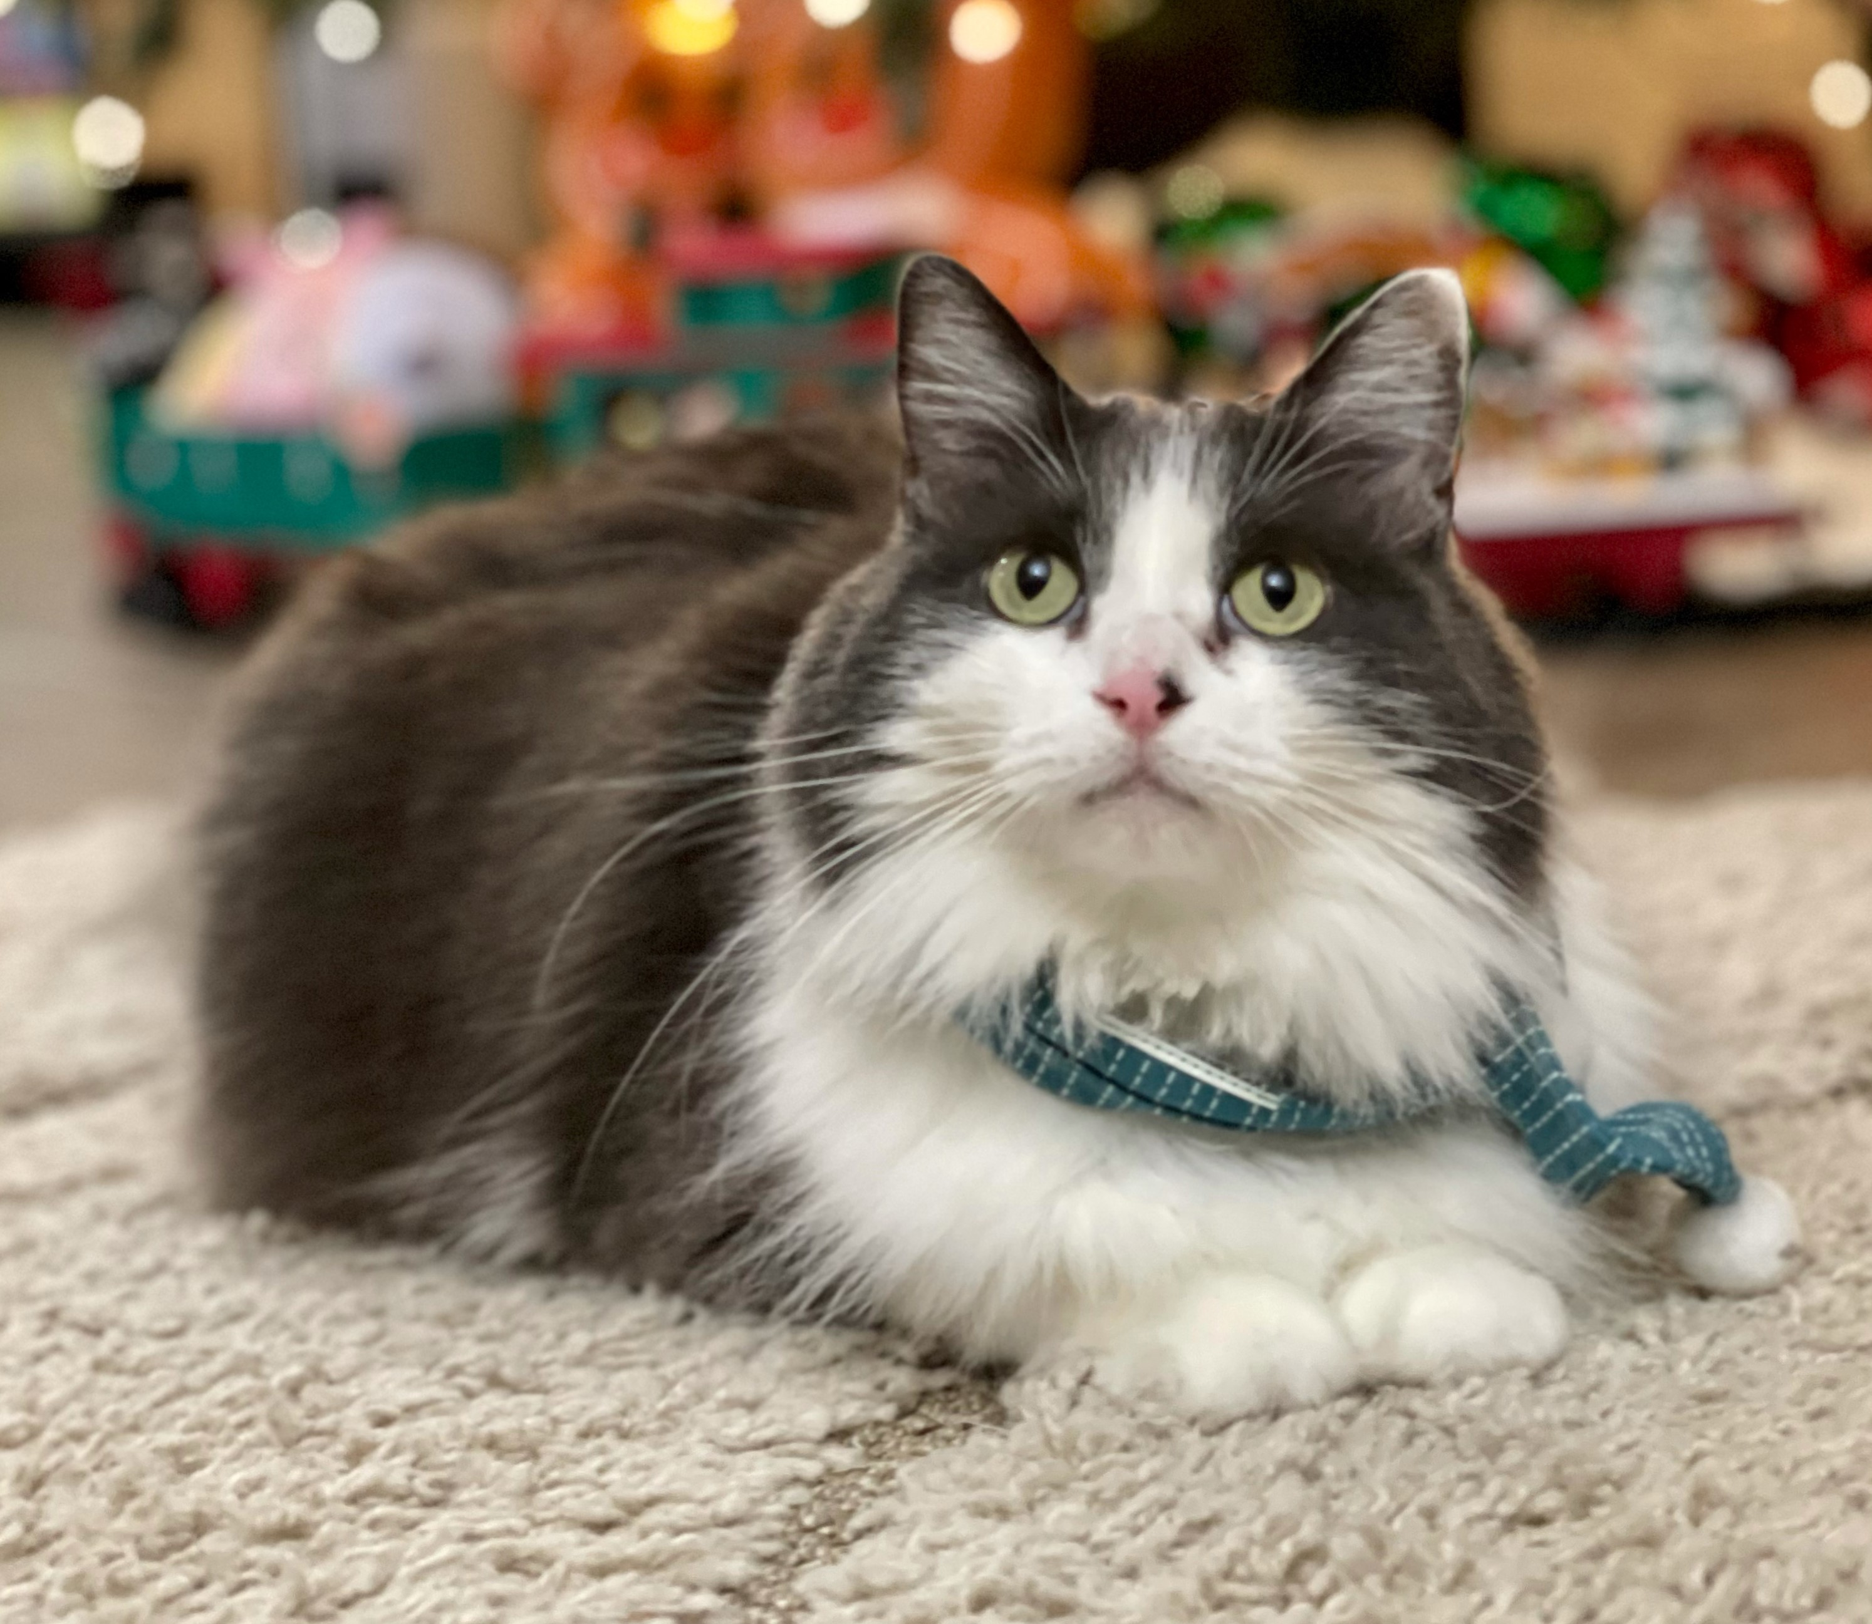
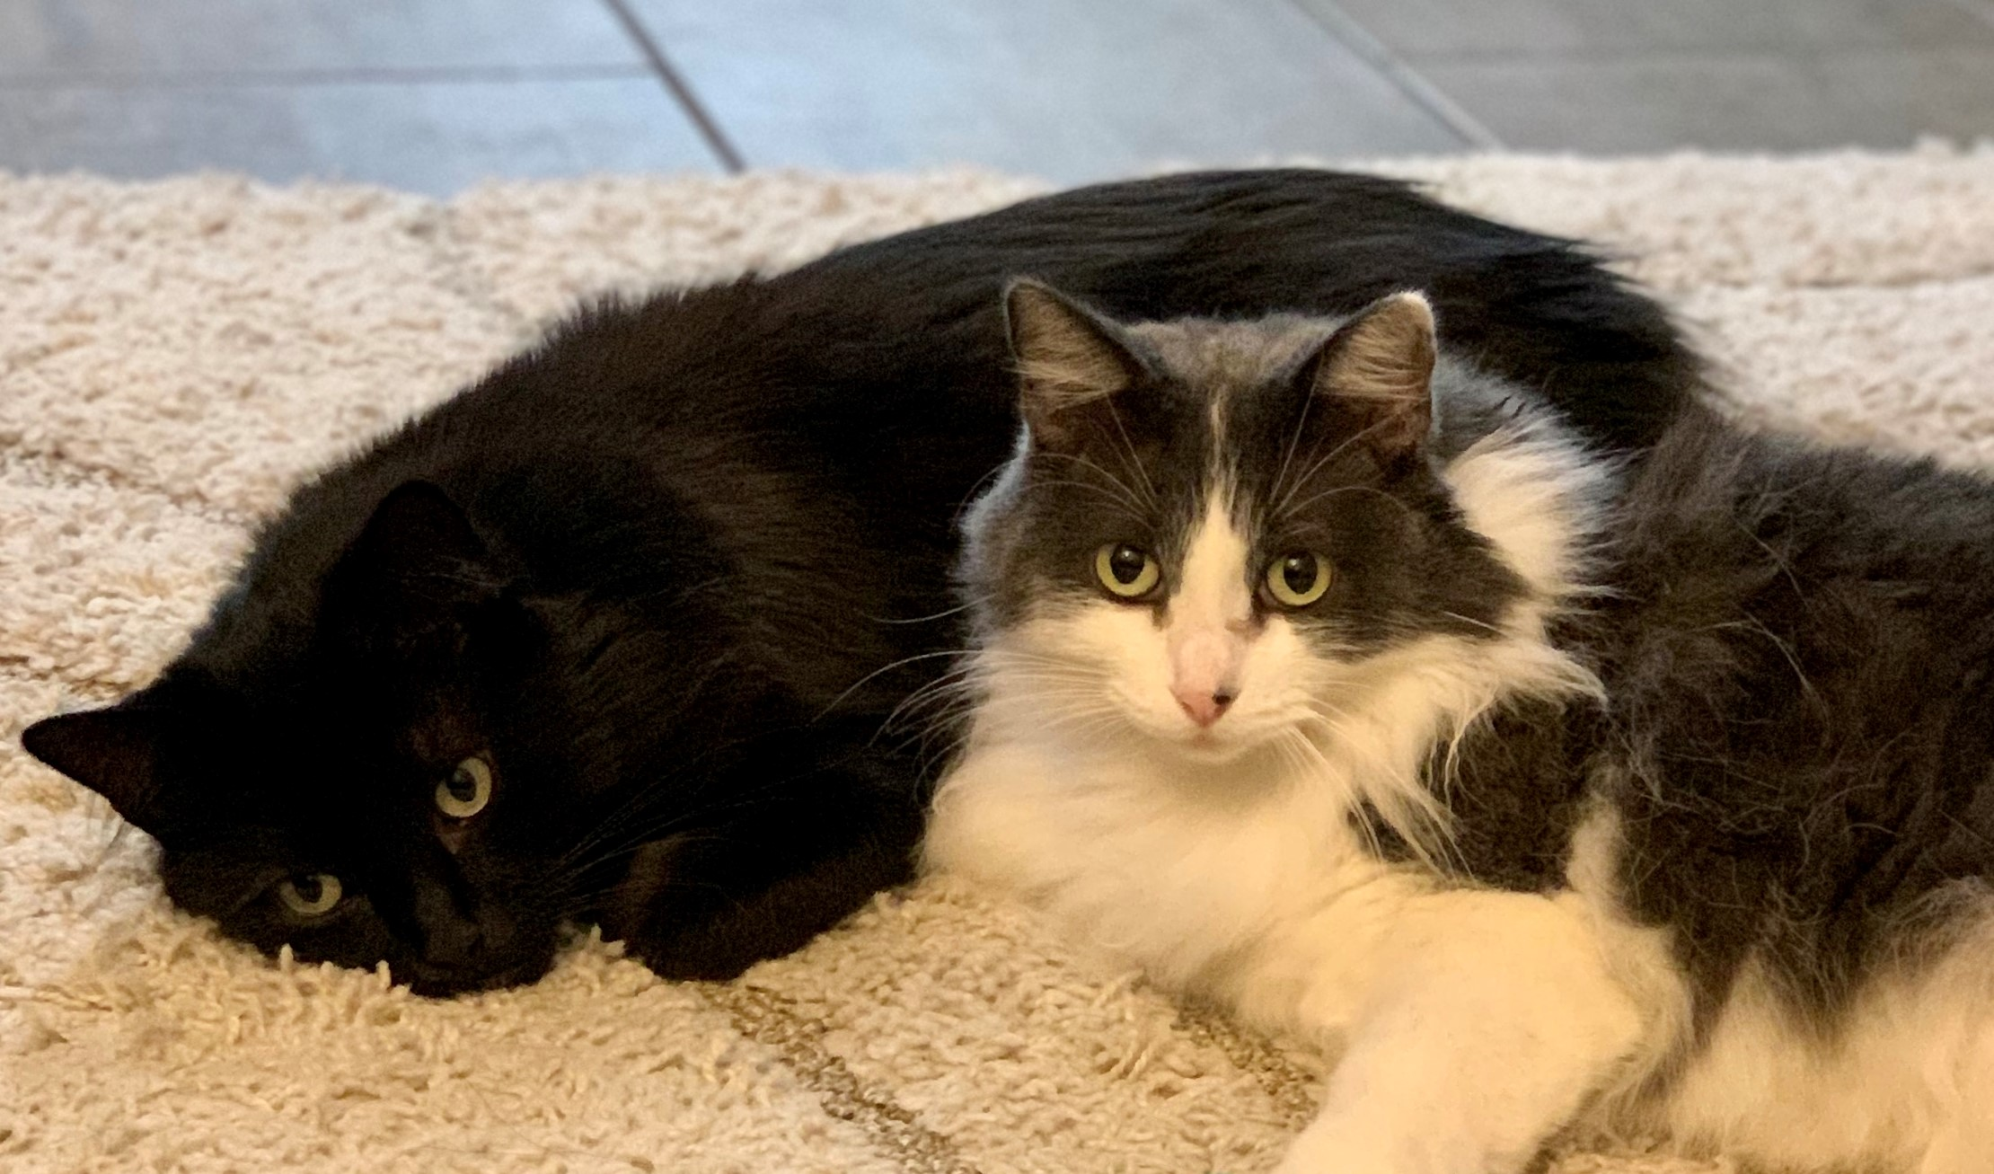
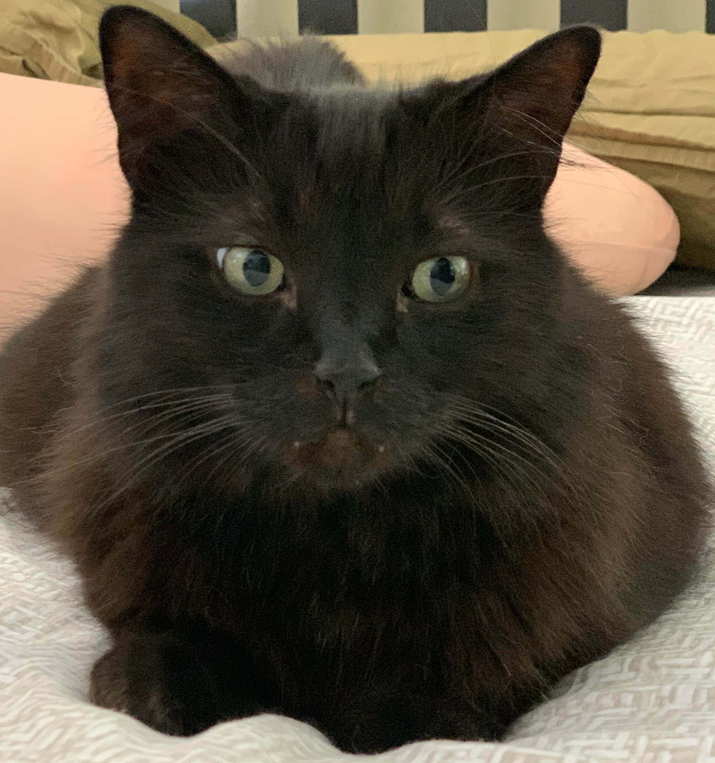
Background
MSOL, Engineering Data Science – UC Riverside
B.S. Electrical & Computer Engineering Technology- Cal Poly Pomona
Engineer at Raytheon Technologies
Coding, 3D Printing, R/C Heli’s & Drones, Electronic Projects
Proud owners of 2 adopted shelter cats (Pebbles & Shadowfang)
Notes:
Here’s a short background about myself. This is my final quarter enrolled in the MSOL Engineering Data Science program at UC Riverside. It’s been a pleasure pursuing my studies at the university and look forward to using it as a stepping stone to new adventures in my career. I completed my undergrad at Cal Poly Pomona in Electrical and Computer Engineering Technology.
I serve as an engineer for Raytheon Technologies, previously Collins Aerospace for over 16 years. Over those years I’ve worked as a test engineer, electrical engineer and now currently a manufacturing engineer. My initial motivation to pursuing a data science degree started while working on a government contract during my role as an electrical engineer. It was during 2019, we were working that contract bid which was competing against two other companies. One of the companies was L3 Communications and I don’t recall who the other company was partially due to the fact we didn’t consider them a threat during the competition. The project involved the use of laser-based technologies to detect chemical threats at the surface level and serve as a warning for other ground troops. I was involved with the system integration of personal and COTS based equipment while assisting our software group with the data training aspect. After just scratching the surface to what machine learning was about, I couldn’t help to dig deeper and eventually was motivated to pursue a degree in the data science field.
Outside of work I enjoy coding projects, 3d printing space, R/C Heli’s, Drones, Airplanes etc, and of course electronic projects in general.
Another motivation behind this study was my wife and I are strong believers in adopting animals who are in need of a home. The photos at the bottom of the slide are our two adopted Maine Coon cats, Pebbles adopted at 2 years of age, and Shadowfang at 5 years.

Slide 3
Overview
Over 6.5 million dogs and cats are placed in shelters each year.
1.5 million shelter animals are euthanized in the U.S. each year [1].
Shelters consist of Traditional & No-Kill facilities [2].
Physicians administering euthanasia adversely affected emotionally and psychologically by their experiences [3].
Austin Animal Center, known for being the largest no-kill shelter also maintains one of the largest active databases.
Notes:
I’ll now discuss the overview of the project.
In the United States, over 6.5 million dogs and cats are placed in animal shelters each year. While these shelters are temporary homes for these fortunate furry critters, there’s an offhand chance they could be euthanized, healthy or not if a permanent home isn’t found in time.
For the unfortunate pets unable to find a permanent home, each year approximately 1.5 million shelter animals are euthanized in the United States (670,000 dogs, and 860,000 cats) .
In the US there’s two types of shelters: traditional and no-kill establishments. Traditional shelters will euthanize animals depending on various circumstances while no-kill shelters will do their best to keep animals alive regardless of a overcrowding status of the facility.
With the help of a published data set maintained by Austin Animal Center, the largest no-kill animal shelter in the US, I will be investigating which characteristics have the highest correlation with successful adoptions. Further investigations will be performed to find additional correlations from the varying characteristics within the data.

Slide 4
Overview (cont.)
Using existing machine learning models, develop a useable tool for animal shelters determine if a pet is more likely adopted.
Benefits animal shelters by saving time and resources.
Development of the analysis tool consists of 2 phases:
Data Exploration + Data Cleaning
Compare the two machine learning models and analyze the results.
Notes:
Using some of the most widely used machine learning models, a predictive outcome methodology would be developed to compute the likelihood of an animal being adopted. This project will serve as a tool for animal centers to determine if additional emphasis should be spent on those animals who are less fortunate and could use additional attention to help influence a successful adoption.
Having this additional knowledge why animals with certain characteristics have greater difficulty finding homes could be helpful for animal shelters to place additional effort and time when marketing them. For example, what are the most attractive names of pets that seem to be adopted? And would giving an animal name such as “Pebbles” or “Cookie” entice lookers to research more about a prospective pet.
The general steps that will be processed to develop create the analytic tool that will help forecast the likelihood of adoption will consist of two phases. The first phase will involve data processing which consists of cleaning of the data, removing incomplete entries, feature engineering, and assigning numerical values to categorical data. The second phase will involve testing the data set with various machine learning algorithms such as random forest and logistic regression classifiers. After completing the second phase, further analysis will be made which involves comparison of false and true positive scoring before settling on a model. Having such tools developed will serve to benefit all types of animal shelters around the world and would not be exclusive to cats and dogs.

Slide 5
Significance
Could be utilized for other types of animals.
Reduced total euthanasia performed yearly.
Shorter shelter stays allows for additional animals in need of fostering.
Less strain on animal shelter staff
Serve as a basis for future research
Notes:
On this slide I’ll go over any additional significances.
Having such tools developed will serve to benefit all types of animal shelters around the world and would not be exclusive to cats and dogs.
Some of the obvious benefits include reduced animal shelter stays and less euthanasia’s performed.
Having shorter shelter stays would allow for additional rescues to be made to other unfortunate animals instead of otherwise be turned away due to overcrowding.
A byproduct of having less euthanasia’s performed in shelters, would be less of a burden that’s created on the staff who perform them.
While the idea behind this project has been explored before, re-visiting this with the latest advancements will yield an improvement in accuracy or at the least confirmation of previous findings, given the maturity of current machine learning models and larger data set. This project would pave the way for further advancements that could involve what states or locations have poor adoption rates and determine what the tradeoff is between adoption time versus relocating the animal to another shelter with higher adoption success.

Slide 6
Literature Survey

Slide 7
Literature Survey

Slide 8
Methodology
What’s out there to get this project started?
Machine Learning model is only as good as the data fed into it.
Find a suitable data set that makes sense for the study.
Settled on the data set maintained by Austin based shelter.
Notes:
These next series of slides I’ll be going over the methodology behind the project.
With the understanding that the use of Machine Learning as a tool is only as good as the quality of data that is fed to into it. This set my first goal to search for useable available data set before considering any web scraping techniques.
In my search for data, there were shelters with very detailed data sets that included as much as 23 features per animal such as how they were adopted, how long their stay was, and if it was a transfer. Unfortunately, as detailed as some of the data sets were, these sets had as few as ~10,000 rows of data.
It wasn’t until coming across a shelter based out in Austin Texas that consistently updates and releases their shelter data for the last eight some years gave promise that there exists a reasonable amount of data to generate accurate and predictable models for the project without too much difficulty. The animal shelter based in Austin provides shelter to ~18,000 animals per year and is known as one of the largest “No Kill Shelter”. The latest 2021 data available has approximately 125,000 data points in the data set. Having a large data set will be beneficial for achieving good model performance with the thousands of examples per class. Nonlinear classifiers such as random forest or logistic regression will benefit tremendously from this amount of data.

Slide 9
Methodology
We’ve decided on the source of the data set, what’s next?
Data Exploration
Clean
Feature Engineering
Data split into 70:20:10 (Training:Validation:Test)
Compare the scores of each classification used
Notes:
The first step to understanding the data is performing an exploratory data analysis to gain further understanding to the most obvious traits that impact adoption rates. Before taking a peek at the data, the entire set will have to be pre-processed and cleaned up removing any anomalies or major data points that could skew the analysis. Because we’re dealing with a relatively large data set, I would simply remove any of the anomalies such as missing labels and not attempt to artificially fill them. If there are a substantial number of rows with incomplete features, I will attempt to handle them accordingly with various techniques. The data will be looked at holistically before manipulating the data in segments. The step will be to analyze each animal by type e.g., cats and dogs. Within each type there’s multiple classifications for each animal that range from “Return to owner”, “Euthanasia”, “Adoption”, “Transfer”, and “Died”. All Categorical features as well as the Classification will be one hot encoded while numerical features will be scaled accordingly. A feature that will be carefully processed will be the “age upon outcome”, which currently has varying unit values in days, months, and years. This feature will be converted into days understanding that converting one-year or two-year values will have a coarse increment of 360 days to 720 days or etc. after it exceeds a year of measurement.
How well the models perform in regards to classification accuracy, Precision, Recall and F1 score, additional post processing may be performed such as re-visiting our “Feature Engineering” step which will be to add additional features such as coat patterns of the pet. For example, for dog breeds of type dalmatian, a description of “white spotted” would be added. The data simply lists the age of the animal by year and will need to create a feature that indicates if the animal is a kitten/puppy, adult or even elderly. Depending how well or poorly feature engineering is implemented, the newly created feature(s) may be thrown out to avoid adding complexity to the model and adversely affecting the analysis.

Slide 10
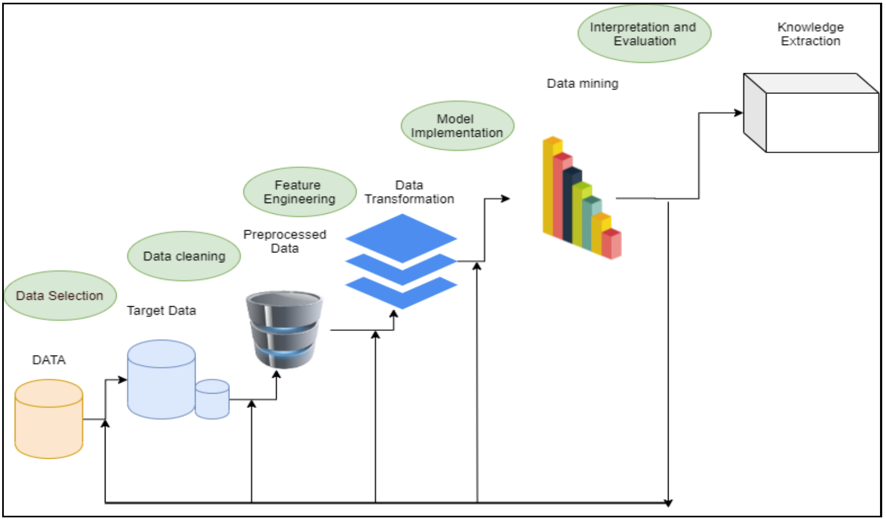
Methodology (cont.)
Figure 1: KDD Methodology
Notes:
With the data set compiled, an evaluation of the size will determine which models would be used. The first machine learning technique will be using Random Forest Classifier as it’s known to perform exceptionally well with a data set as the one that’s being analyzed. Attempting to achieve the highest series of scores would be achieved by adjusting the various parameters such as “maximum features”, “number of decision tree classifiers”, “minimum amount of leaf nodes “. Performing an analysis using a logistic regression classifier would also be performed and compared to the previous algorithm used. Attempting to yield the highest series of scores will be made through hyper parameter tuning steps. Both models will be used to test for accuracy against the test set. Depending on the results, the best model would be used toward creating a predictive program in determining adoption success rate. Summarizing all the steps that was just discussed follow a general KDD methodology as seen in Figure 1. The reasoning to staying consistent with a KDD methodology is at an abstract level, the KDD field’s primary focus is with the development of methods and techniques for making sense of data (Fayyad et al., 1996).

Slide 11
Methodology
Data Collection
Notes:
This section consists of the primary data set that was used for this capstone. At the time while working with the data set from Austin Animal Center Shelter, the total data set consisted of over 125 thousand inputs with a time range from 2013 to 2021. The input data was timestamped down the hour of the day. The reason for settling on the data set provided by the City of Austin was made because it was known for being the largest no kill animal shelter with the largest publicly available data set. The data set was imported directly from the Austin animal web portal. Within the data set included features: animal id, name, datetime, monthyear, date of birth, outcome type, outcome subtype, animal type, sex upon outcome, age upon outcome, breed, and color. The feature that we will consider the target output variable will be outcome type which included: adoption, died, disposal, missing, relocate, return to owner, return to adoption, as well as unwanted labels that would need further processing to clean up. All other features outside of “outcome type” were used in the classification to build the machine learning model.

Slide 12
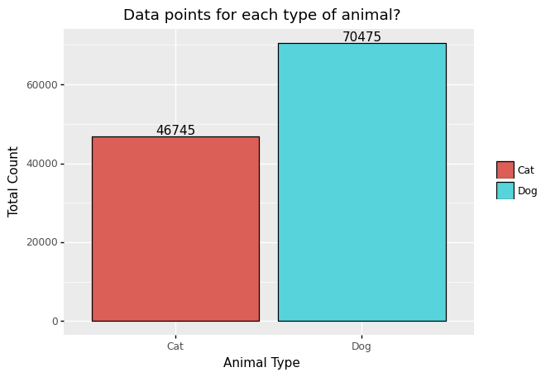
Methodology (cont.)
Figure 1: KDD Methodology
Notes:
Before building up any models the first step was to analyze the raw data points in the data set to see what we were working with. Upon searching for all the unique animal types entered into the database we found the data base consisted of cats, dogs, bird, livestock and other animals. To minimize any data confusion and keep the scope of the project minimal all animals other than cats or dogs will be removed from the data set. Removing all the unwanted animal types from the data set trimmed our total entries of 125 thousand down to 117 thousand shelter inputs. The breakdown between cats and dogs can be seen in figure 2.

Slide 13
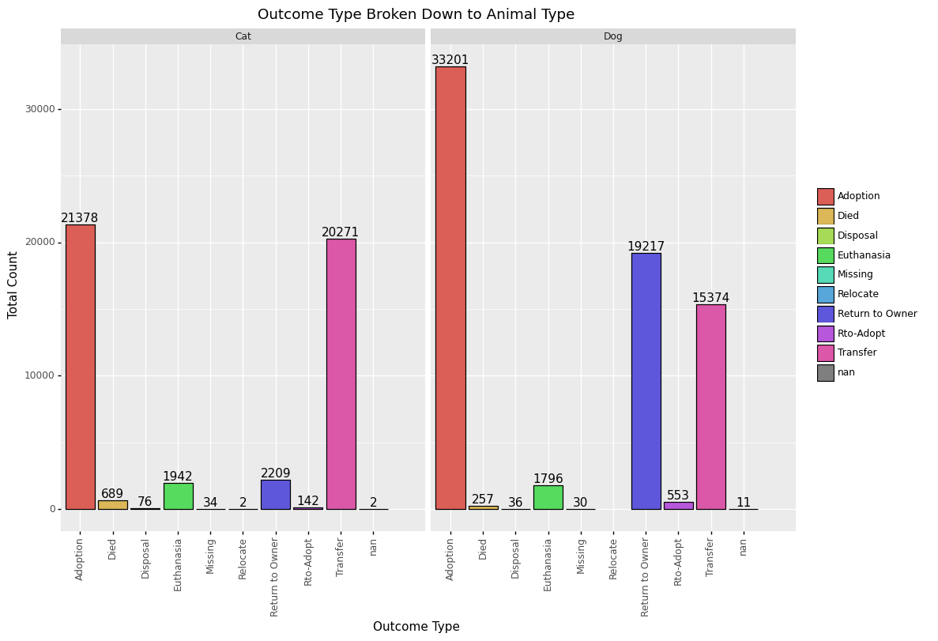
Methodology (cont.)
Figure 1: KDD Methodology
Notes:
Further steps were then made to understand the outcome types broken down between cats and dogs. Figure 3 shows the breakdown between animals and gives us insight that cats seemed to be Adopted less, less chances of returning to owners and have higher shelter transfers. While are the opposite with higher chance of adoption, higher return rate to owners with a lower ratio of transfers to that of cats.

Slide 14
Methodology (cont.)
Figure 1: KDD Methodology
Notes:
Looking at figure 4, it’s seen that one of the major features that have a correlation to adoption rates is whether or not the animal is spayed or neutered. Unfortunately, this may be an example where correlation does not imply causation. Further research found that a majority of states have implemented a mandatory spay and neuter law to help with the overpopulation of homeless animals (Hodges, 2010).

Slide 15
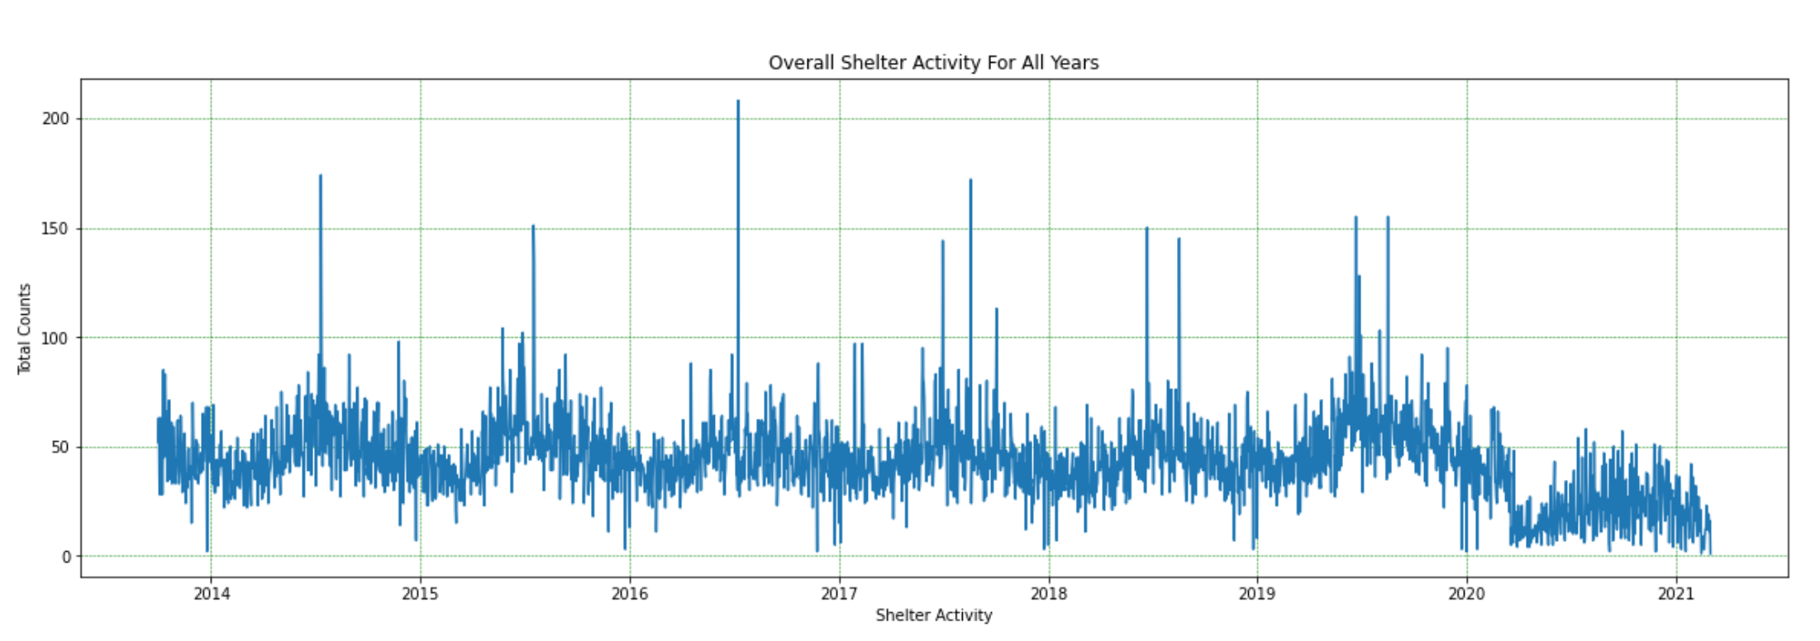
Methodology (cont.)
Figure 1: KDD Methodology
Notes:
Using the date time feature which is also the for time of intake for each data entry it was possible to perform a time domain analysis on the overall shelter activity shown in figure 5. From this we could see during the summer of every year activity slowly ramped up and spiked before settling down by the end of the year. This gives us further insight that shelters are very overwhelmed during these periods of the year and could use any bit of help to reduce the strain. An article pointed out that during the peak seasons of animal intakes is also the same time pet adoptions temporarily dip (Muñoz, 2019).

Slide 16
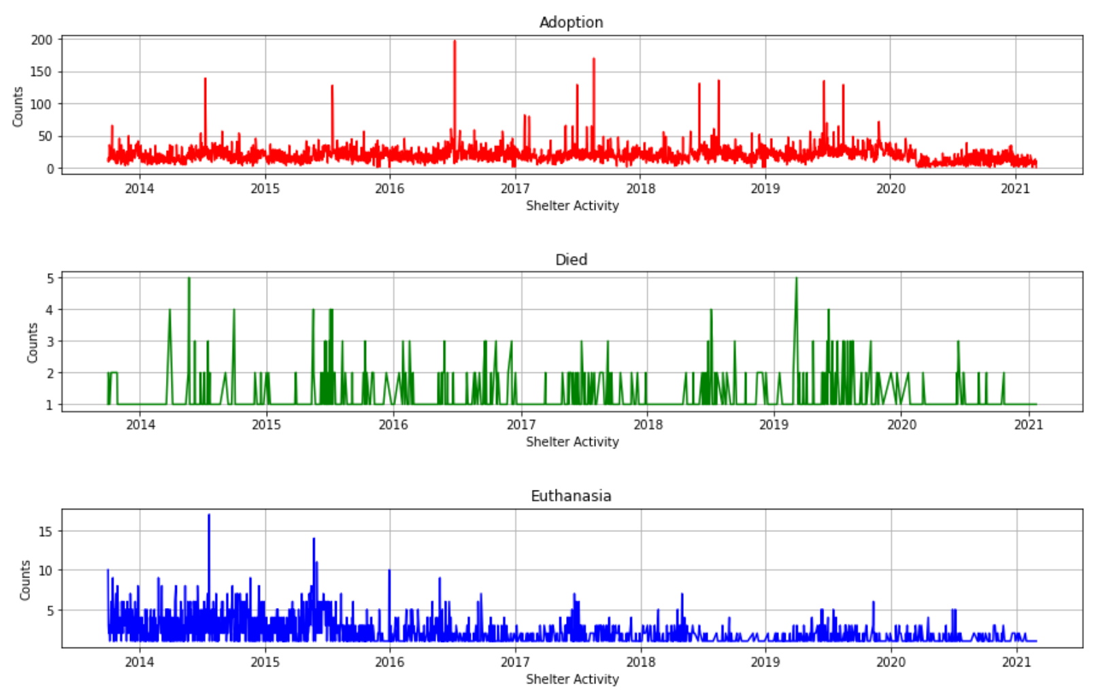
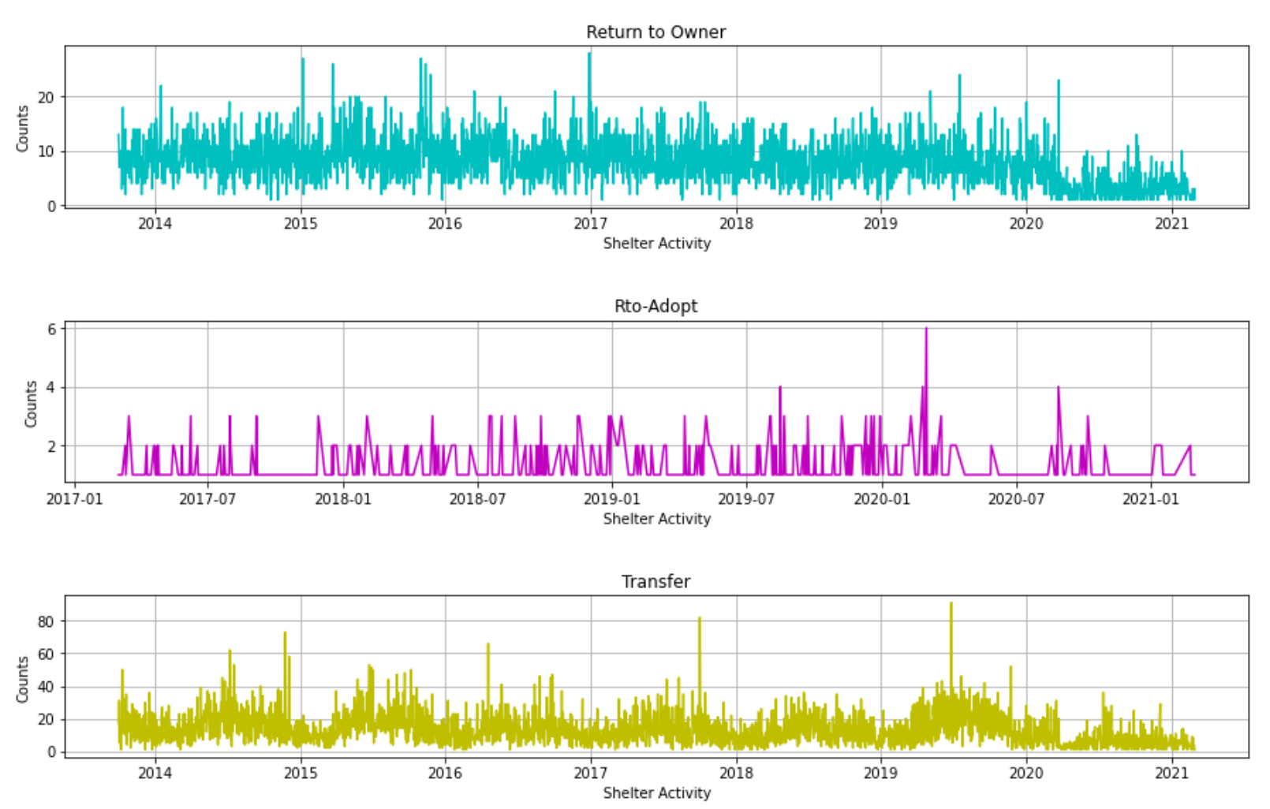
Methodology (cont.)
Figure 1: KDD Methodology
Notes:
Taking the overall shelter data and breaking it down into the possible outcomes: return to owner, return to adoption, transfer, adoption died, euthanasia we can chart the data over time seen on figure 6. To perform this step, all the data was merged into a single day before it was charted. Judging from the data it seems that euthanasia’s performed gradually lessened throughout the years while animal adoption stayed consistent.

Slide 17
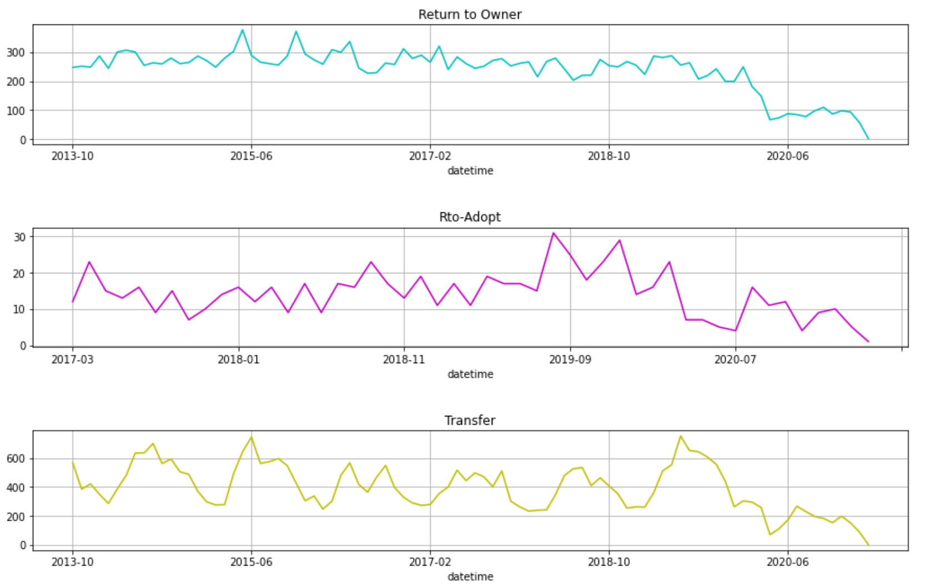
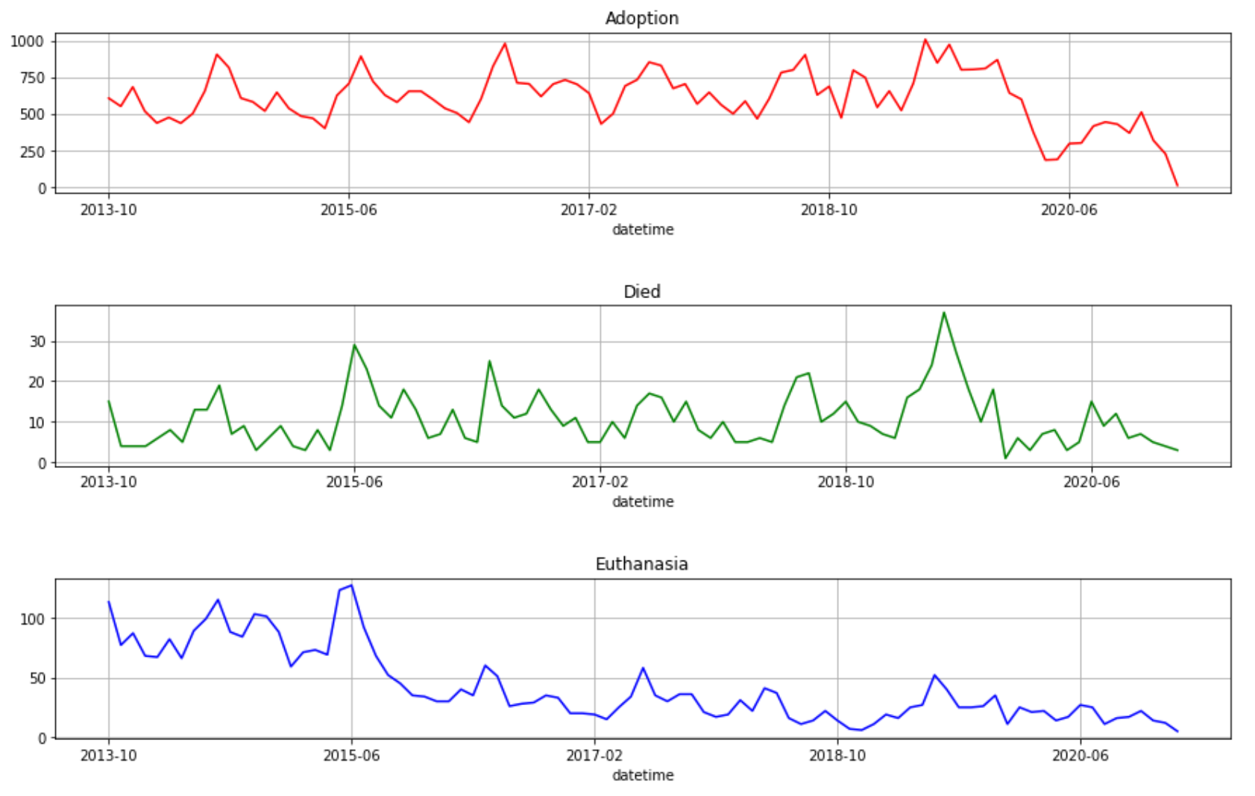
Methodology (cont.)
Notes:
To possibly reduce any additional noise the data was further reduced by removing the individual days and simplify the time stamp to just contain month and year as shown in figure 7. Personally, I was unable to deduce any information from the graphs that could assist with improving the model.

Slide 18
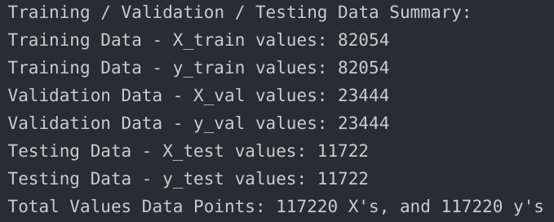
Methodology (cont.)
Figure 1: KDD Methodology
Notes:
After getting an idea what the data looks like the next step was to perform a series of feature engineering steps. Some basic administrative steps were made to make it easier to work with the data such as replacing all spaces in the feature names with underscore and text to lowercase, dropped all animals that were not dogs or cats, and remove any entries that did not have any age outcomes. To keep the scope of the study relatively simple we set successful adoptions to a numerical “1” while anything other than adoption was a numerical “0”. Before moving further, the data was checked for any missing/empty data in a given row. The original date time for each entry was not suitable to be used for training due to its complex format of day-month-year-hour-minute-seconds-am/pm format. A simple function reduced this down to a calendar day for all data points. Another issue that needed to be resolved was the varying units used for age upon outcome. Instead of using units of years, months, week, or days, a function was created to convert all animals to age in days. Because we’re dealing with a large data set of categorical values, label encoding is used to convert them to numerical values in order for machine learning models to accept them as training input. To remove as much noise from the model, features such as animal id, index, redundant features were removed. The adopted feature which was derived from the outcome type was also dropped and be used as the target output values to train the model against. At last, the data was split into a 70:20:10 split of Training, Validation, and Test. Figure 8 is the detailed breakdown after the data is processed through the split function.

Slide 19
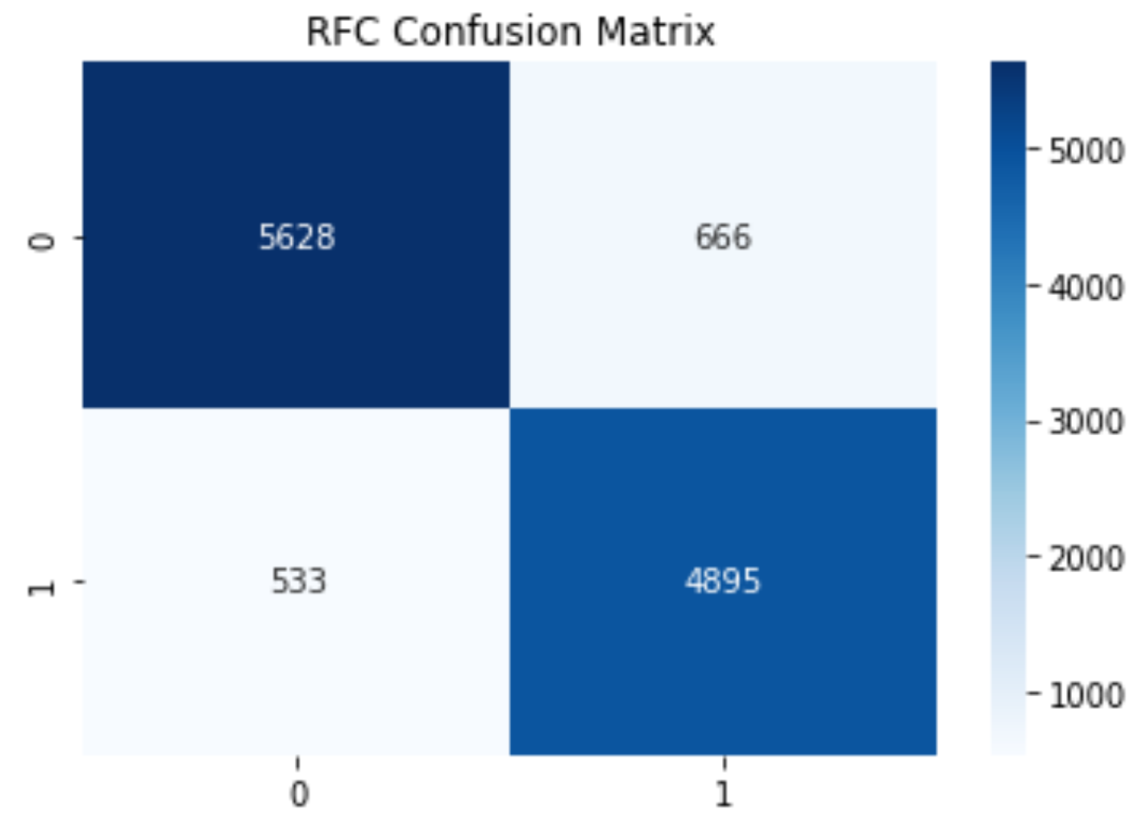
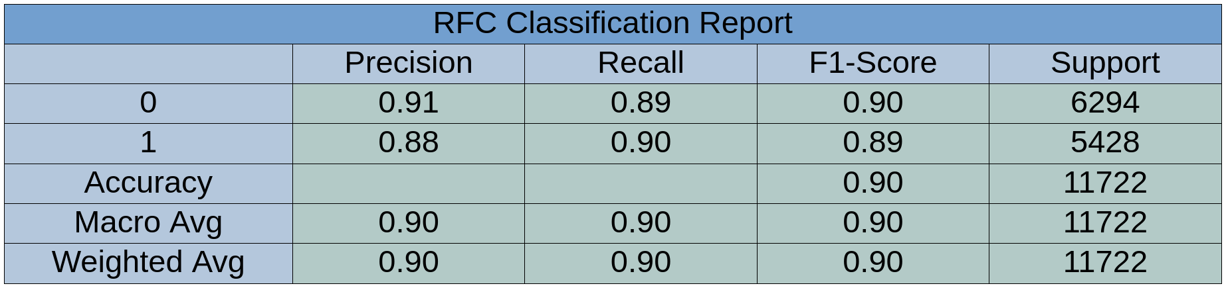
Results (cont.)
Figure 1: KDD Methodology
Notes:
To gauge the performance of the model we scored for accuracy, precision, recall and f1 score each time the model was trained/fitted. Accuracy: is how many of the predictions were correct, Precision: out of all the truth predictions, how many were correct, and recall: is out of all the possible truths, how many were correct. Closer attention is given to the F1-score which is a combination of both precision and recall to ultimately measure the accuracy of the model (Riggio, 2019). The results from the random forest classifier are shown in figures 9 and 10. True negative of 5628 versus it’s False negative of 533 gave us an accuracy score of 91%. While True positive was 4895 with a false positive of 666 yielded an accuracy of 88%. Precision, Recall and F1-Score averaged out to be approximately 90% which is surprisingly accurate in predicting the success of adoption.

Slide 20
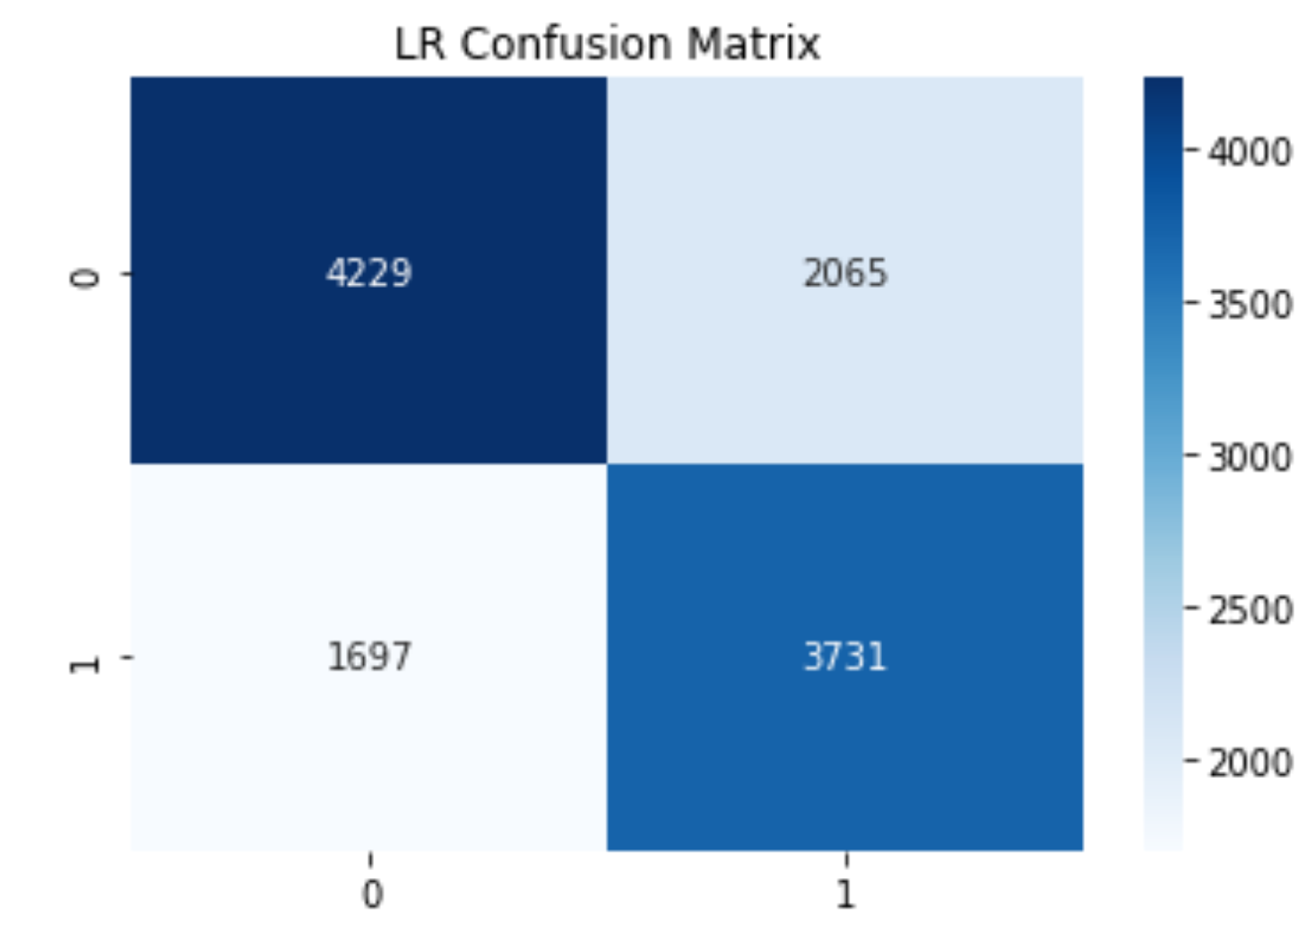
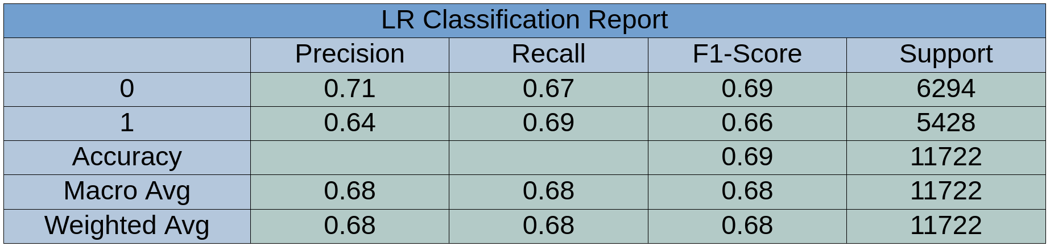
Results (cont.)
Notes:
The results from the logistic regression classifier are shown in figures 11 and 12. True negative of 4229 versus it’s False negative of 1697 gave us an accuracy score of 71%. While True positive was 3731 with a false positive of 2065 yielded an accuracy of 64%. Precision, Recall and F1-Score averaged out to be approximately 68% which is substantially lower than what we scored for the random forest classifier.

Slide 21
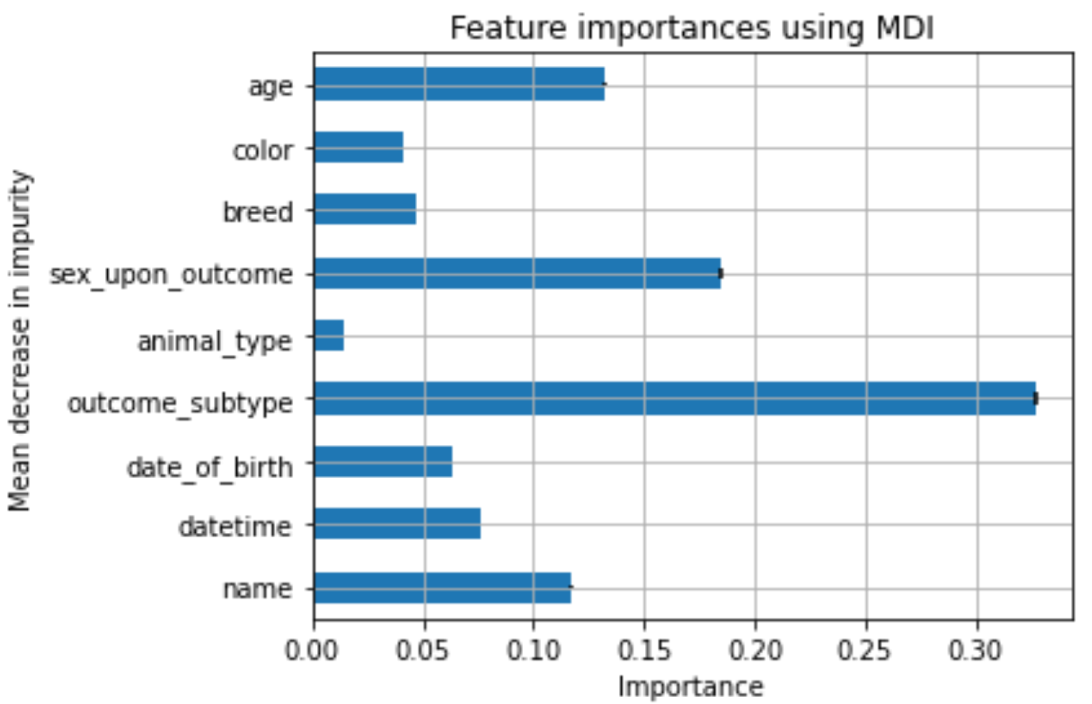
Results (cont.)
Figure 1: KDD Methodology
Notes:
Comparing the results from the two classification algorithms it was determined to settle with the random forest classification. Figure 13 visually displays the associated weights for the various features that the random forest model perceives. The most important predictor in predicting the outcome seemed to be the outcome subtype which consists of variables such as behavior, in foster, aggressive, suffering, and etc. Second to outcome subtype was age of the animal which is consistent with the idea that younger animals tend to be adopted more easily. This is the case due to senior pets, even those that are a few years old normally languish in shelters because people prefer a younger pet (Brown, 2020).

Slide 22
Discussion
Notes:
Our primary research goal was to find a suitable model that could accurately predict the outcome of animals to determine if additional assistance is necessary to help those that are not as fortunate. The complete analysis also was able to find correlations to what factors have the highest weight in determining adoption likelihood. While figure 13 gives sex upon outcome a relatively high weight, it may not be as important due to the workings and operations of how shelters operate when it comes to spaying and neutering. Looking back at the experimentation process, having reduced the estimators and depth to a minimal single digit value could have yielded a clearer graphic representation of how the model is behaving. While the full random forest model correctly identifies ~90% of the animal adoptions, further work should be done to verify the validity of the accuracy before accepting it at face value. The logistic regression model’s ~68% score was in line with what other researchers came across when using similar models and data sets.

Slide 23
Conclusion
Notes:
The results that we’ve concluded to can be used by the shelter to help narrow down which animals would have difficulty being adopted and make changes to the resources spent. With this initial study set, our model could be used as a baseline to look into other variables such as how long an animal is kept in shelter, intake age, and even outcome age. While the high score that the random forest classifier achieved was very promising, it’s not clear where the decision thresholds are without extracting all the trees generated by the algorithm and analyzing them together. An attempt was made to reduce the total estimators and maximum depth, but performance of the model drastically suffered to where it performed on part or worst than the logistic regression model. Another improvement that could be made to the existing model would be to creating filter categories for some of the features that have large amounts of unique variables such as color or breed of an animal. While the color featured displayed over 500 unique values, the breed feature had over 2,000 varying breeds. Creating a comprehensive filter function would have taken more time allotted but may serve to help improve the consistency of the model.

Slide 24


Overview
Egalitarian Leadership Style:
Relies on a team for direction and discussion
Patient and likes planning and team discussion
Works for most companies but best in smaller ones
With in-person meetings, there is quicker decision making
With virtual meetings, there was a higher focus on work related issues
Notes:
Today we will be talking about Egalitarian Leadership in specific. In this type of style, leaders prefer to lean on their team for new ideas and perspectives on a project. They benefit from the discussion and the team itself does a better job when they feel included and responsible for the outcome. With this leadership style, planning and patient is essential to any project. Smaller companies benefit the most from this style since it is easier to implement than a larger company with hundreds of employees, but it is possible. With the pandemic, many companies had to do everything virtually. Those using egalitarian leadership had similar positives when it came to meeting virtually or in person.

Slide 25

Leadership - prospering in technical teams
Grounded foundation. (Blanchard & Blyler, 2016, Ch.1.5 System Engineering Management)
Aligned qualities and attributes. (Bennis, 2009, pp.33-42)
Corporate Context (Meyer, 2017, pp.75-77)
Top-down egalitarian
Consensual egalitarian
Leader-Contextual Culture fit
Notes:
As Delicia has mentioned, the chosen topic that we will go over is leadership for engineering teams and specifically what kind of management approach would work best depending on the circumstances. Being considered the most difficult management skill to master in an organization, as covered in class, leadership encompasses a multifaceted competence that successful managers not only possess but also adapt, develop and execute on a continuous basis. Cumulatively defined on the basis of relentless commitment and support to the mission of the organization(Blanchard & Blyler, 2016, Ch.1.5 System Engineering Management), the individual qualities and attributes that build a valuable leader like responsibility, passion, vocation, dedication and expertise to name a few (Bennis, 2009, pp. 33-42), can be argued to be truly effective when aligned with highly significant external factors that permeate a modern globalized marketplace, such as corporate culture and/or context. Tuned to a precise combination of a hierarchical or egalitarian approach, the narrowed sector of industry that technical fields such as engineering require further define these to a top-down or consensual version each of which are uniquely appropriate under the right conditions (Meyer, 2017, pp. 75-77) that are further bounded by the surrounding context that they are applied to. Evermore so guaranteeing a successful implementation, in the case of a technical field it would most likely take the form of a top-down egalitarian approach in the west, given not only by the conventional organizational structure but also the environmental framework, which just like in any other parts of the market the optimal solution would most likely be defined by such factors and the ability of the individual to favorably gratify the opportunity in what I call the leader-contextual culture fit.

Slide 26
Traditional management
Traditional management emphasizes the planning of work, the organization's technical requirements, the principle of management, and the assumption of rational and logical behavior.[1]
In traditional management, organizational structure plays an important part.
Traditional management focuses on "tall hierarchy". It means teamwork is an individual responsibility, and an individual should obey their superiors.
Management policies are conservative. So it follows traditional rules and regulations makes a stable and static business model[2].
Notes:
[1] Robbins, S. P., & Judge, T. (2018). Essentials of organizational behavior.
[2] Weymes.,E (2004) A challenge to traditional management theory

Slide 27
Engineering management
Engineering management is a specialized form of management. That focus is to lead technical personal and projects.
It is based on scientific theory and experimental outcomes[1].
Based on the technical project than organizational sections.
Modern managing practices like agile management, scrum management are an example of engineering management.
Organization hierarchy is dynamic based on the project.
Hierarchy is sometimes not a decisive factor for project success.
Notes:
[1] Omurtag, Y.. (2009). What is Engineering Management? A New Look at an Old Question. Engineering Management Journal. 21. 3-6. 10.

Slide 28
Egalitarian management in traditional management
Egalitarian type management generally uses a flat corporate structure.
Traditional style management prefers hierarchy in an organization, so it is challenging to apply egalitarian style management in a large corporation with traditional style management.[1].
However, In a small-scale business like small dairy or cotton spinning gin, an egalitarian style management approach can be used even with traditional management.[2]
So, egalitarian style management may be applied with traditional management given that business is not involving relatively complex processes.
Notes:
[1] Trevor-Roberts, E, Kennedy, J.(2003) The Egalitarian Leader: A Comparison of Leadership in Australia and New Zealand
[2] Lee, Michael & Edmondson, Amy. (2017). Self-managing organizations: Exploring the limits of less-hierarchical organizing. Research in Organizational Behavior. 37. 10.1016/j.riob.2017.10.002.

Slide 29
Egalitarian management in engineering management
Another side, In engineering management, A couple of examples exist that give evidence about egalitarian style management success.
It is possible to apply egalitarian management successfully with engineering management, even for large organizations.
Software companies are encouraged to apply egalitarian style management in their engineering departments and engineering management.[1].
For example, Facebook Inc. Netflix.
Notes:
[1] Dean, P. (2007) FLAT AND EGALITARIAN? EVALUATING WORKER HIERARCHIES IN SOFTWARE COMPANIES

Slide 30
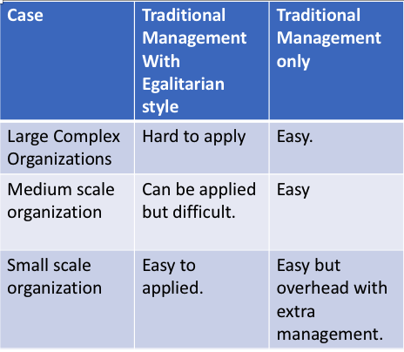
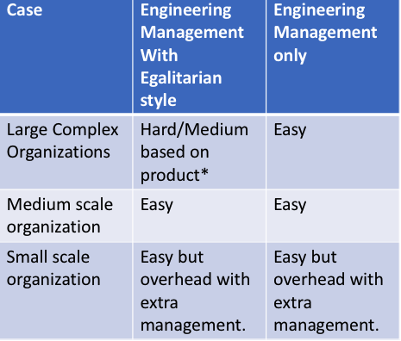
Egalitarian management in Traditional vs Engineering.
Notes:
* For software organizations, it is easy to apply.

Slide 31
Examples
Agile and SCRUM Project Management
Consulting Teams
Start-Up Companies
Self-organizing teams
Top Management team
Managerial Implications
Notes:
In a case study analyzing agile development and Scrum project management, it was shown that these types of project management are successful when the team and team leaders share leadership. The leadership is rotated to the person with the key knowledge, skills and abilities. In Scrum, it was suggested that team leadership should be divided among the product owner, scrummaster, and the self-organizing team. The team members could lead when they possess the knowledge needed at that phase of the project. For instance, the most knowledge person becomes the scrummaster and gets the right people together on a small team.
-During the growth stage of startup companies, various duties must be performed and it not ideal for the founder to take on responsibility. In a study monitoring start-up companies, leadership among a skilled and diverse top management team produces the best outcomes
-In a study observing the performance of consulting teams, managers suggest promoting internal leadership of teams by setting expectations. They suggest to employees to view themselves and fellow team members as leaders for a shared leadership perspective. Managers should ensure that each team has a clear sense of direction and purpose to foster a positive environment where the members encourage one another. Also, managers can engage in supportive coaching in the form of encouragement, reinforcement, and rewards.

Slide 32



Corporate Examples
W.L. Gore and Associates
Lattice structure
PIXAR
Pixar University
Google
70-20-10 norm for time allocation of employees
Philips
Philips innovation campus in India
50 % rule
DPR Construction
Global Learning Group
Notes:
Companies with egalitarian cultures invest in projects proposed by employees for new product development, as well as offer education and training opportunities. Innovation is associated with employee participation and decision making which promotes the desire to contribute to the organization’s success.
At W.L. Gore and Associates, Bill Gore operates with a lattice structure that creates an environment where employees interact with one another without going through the chain of command. Instead of managers, there are leaders that emerge because they gain credibility with other associates. Gore also implements knowledge based decision making where decisions are made by the most knowledgeable person, not a person in charge.
At Pixar, Ed Catmull fosters community. He created Pixar university where employees learn new skills not meant to enhance employee job performance but teach employees to respect colleagues work. He also created “Note’s day” where employees do not work but meet for a townhall meeting encouraging discussion of how to make Pixar better
-At google, the 70-20-10 norm for time allocation encourages creativity. 10 percent of the time is free time for the employees to pursue ideas based on their interests and competencies. It is said that 50% of google’s new products are generated from this free time. In addition, the choice for a new project is not dictated by founders, but the idea competes based on merit.
- At DPR Construction. Doug Woods implemented a global learning group where all employees are submersed into a learning program where they learn budgeting, planning, scheduling and project management. Woods also ridded of employee titles and has an open floor plan in the company.
-At Philips India, 50% of the innovation team is working in the field 50% of the time. This is to promote continuous learning and serves to build trust between employees and the populations. Its culture is inclusive, nonheirarchic, and empowering.

Slide 33
In-person (Collocated) Vs. Virtual
Egalitarian Management
Higher group decision making, higher input from team, shared resolution power. This can affect collaboration across cultures.
In-person Support | Virtual Support
More bounce interactions, quick problem solving conversations | More focused on work related issues
Fewer emails and virtual calls between staff | Virtual content conversations resulted in higher quality output
Enhances non-verbal communication reading | Reduces pressure to be “always on” during in-person meetings
More informal connections during meetings, more engaged in agenda items | Relaxed communication norms in virtual setting
Notes:
In-person Support Evidence:
More impromptu meetings and spontaneous content conversation can more easily take place when staff is in the office together. If committees and groups are meeting in-person there is travel time to be accounted for as well. During meetings, the group typically is focused on the current meeting’s agenda and likely more engaged. More instantaneous project management updates occur in a collocated setting.
In addition, face-to-face communication is associated with higher levels of consensus within groups, higher perceived quality, more communication, and greater efficiency in completing tasks (Morrison-Smith & Ruiz, 2020).
They found that the absence of body language, subtle voice inflections, facial expressions, etc. cause delays in workers’ decisions whether to trust a new collaborator and impede expression of their own trustworthiness (Morrison-Smith & Ruiz, 2020).
Virtual Support Evidence
Communications in virtual teams are often more formal than in collocated settings and focus more on work-related issues (Morrison-Smith & Ruiz, 2020).
One of the managers that we interviewed reflected on the fact that virtual content conversations resulted in higher quality output due to team members having more individual time to think through ideas (Whillans et. al, 2021).
Communication norms are more relaxed in a virtual group setting, which allows for more creative dialogue between team members. The personal characteristics of team members (e.g., ability, integrity, competence, fairness, honesty, openness) and the level of autonomy in a team play an important part in establishing trust (Morrison-Smith & Ruiz, 2020).

Slide 34
In-person (Collocated) Vs. Virtual
Egalitarian Management
Overall, virtual teams are more open and transparent, which allows for better contribution to the group’s decision making power. However, meeting in-person allows for more informal bounce interactions. A blend of both initial in-person meetings followed by virtual settings could be very beneficial and efficient for project success.
In-person Disadvantage | Virtual Disadvantage
Stricter communication norms during in-person meetings | Instant messages, emails, etc. could more distracting during meetings
Impromptu meetings minimizes time to focus on project | Real-time bounce interaction are more challenging
More travel time required for in-person meetings | Response time on project deliverables may take longer
Notes:
Instant messages and emails could be more distracting during meetings.
Asynchronous nature of communication cuts into other activities: “The downside [of manager responding quickly on Slack] is that my manager seems to respond even in a meeting, potentially compromising its quality” (Whillans et. al, 2021).
However, our informants soon realized that the absence of real-time bounce interactions in the virtual environment made it more challenging to align with their team members and achieve integrated solutions (Whillans et. al, 2021)

Slide 35
Summary
Integration of an egalitarian management is dependent on type of industry, size and complexity.
Implementing egalitarian management into small to medium engineering management organizations is less of a challenge while becomes difficult to implement for anything bigger than smaller traditional management organizations.
Egalitarian style management is necessary to compete in emerging markets.
Generally positive benefits for both In-Person and Virtual Support.
Notes:
While we can agree that there's no one size fits all when it comes to choosing the type of management style to be used in an organization or team, careful consideration hinges on the type of industry, size of the organization, and complexity of the product or product line whether or not to integrate a form of a egalitarian management approach.
A general rule would be for small to medium size engineering management organizations that it's relatively easy to implement some form of egalitarian management while for larger organizations it may start to be questionable depending on the complexity of the product. In regards to trying to integrate an egalitarian style management into a traditional management, it may be relatively easy for small scale organizations, but difficult for medium to large scale companies.
To compete against the emerging & existing profitable companies such as Google and PIXAR, it would be foolhardy not to integrate some form of an egalitarian style management into the organization, whether into an existing top-down corporate layout or a flat structure. It's no question that developing a product with either the agile development methodology or scrum project management is one the fastest ways to bring a product to market.
Overall, the integration of some form of an egalitarian management in an organization has positive effects on personal worth, communications and or collaborations, and productivity for both In-Person Support or Virtual Support. The disadvantages discussed can be alleviated by blending both in-person or virtual communications.

Slide 36
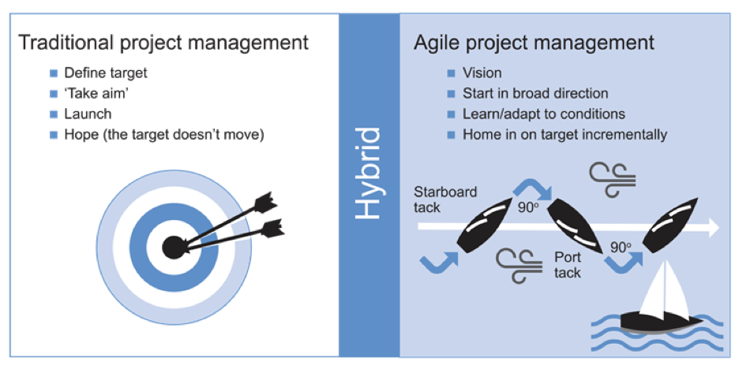
RECOMMENDATIONS
Collaborative working
Iteration
Developed an agile mindset
Hybrid
Notes:
1. For agile project management we should have collaborative working, especially with the customers.
2. In order for the agile management to be successful managers should create a working mindset that helps the team respond effectively to changing requirement as based on what agile management emphasizes in which is the iteration.
3. Developed an agile mindset can enable the project success
4. Agile project management is hybrid therefore it is recommended to be used over traditional project management.

Slide 37
RECOMMENDATIONS
First meeting to be in person
Build Trust
In Person meeting if it is needed in the future
Define and respect Cultural differences
Positioned the camera in virtual meetings
Notes:
In general virtual meetings have a tendency to lose face to face interaction. The body language can be hidden or lost during virtual meetings. Research shows the best practice is to have a face to face meeting at the beginning to build trust and get to know the other side personally, and have small talk between the attendees. Additional meetings may proceed to virtual setting with a caveat to have further face to face meeting if the need arises. For example, if we feel the team is losing track, doesn’t seem to have the same enthusiasm or having the confusion, we should conduct additional face to face meetings.
As we studied in Engineering 200, we should not disregard the cultural differences as they are one of the most important aspects of building trust that is an essential attribute of being a successful manager.
limited bandwidth can result in major shortcomings, frustration, reduced performance and less effective action planning when compared to standard face to face meeting
Speaking time also increases during virtual meetings
various non-verbal communication gestures that occur during face to face meetings might be difficult or impossible to convey to others thereby reducing decision making quality

Slide 38
RECOMMENDATIONS
Human factors that are important in virtual meetings:
Setting the agenda
Taking breaks
Distraction and multitasking
Interruptions
Team building
Review and Summarizing
Conclusion
Notes:
It is important that the chair or leader of the meeting begins by setting a clear agenda and format, discusses timings and ensures that everyone is equally valued
It might be not relevant to the short meetings but for more than 90 min meetings it is important to build in breaks within the agenda.
One of the best practice that has been recommended is placing a mirror close to the computer so the attendee can observe and maintain awareness of their own behavioral all time even when the cameras are off.
Using the headset helps the interruptions.
The powerful tool to ensure the agenda has been met is to summaries key findings.

Slide 39
References
Agile project management. (n.d.). APM | The Chartered Body For The Project Profession. https://www.apm.org.uk/resources/find-a-resource/agile-project-management/
Becoming an effective global manager. (2016). https://doi.org/10.4135/9781473980655
Bennis, W. (2009). On becoming a leader (4th ed.). Basic Books. https://ucr.primo.exlibrisgroup.com/permalink/01CDL_RIV_INST/2qv5p6/alma991032958922004706
Blanchard, B. S., & Blyler, J. E. (2016). System engineering management (5th ed.). John Wiley & Sons . https://search.library.ucr.edu/permalink/01CDL_RIV_INST/64uuac/alma991032973808404706
Carson, J. B., Tesluk, P. E., & Marrone, J. A. (2007). Shared Leadership in Teams: An Investigation of Antecedent Conditions and Performance. Academy of Management Journal, 50(5), 1217–1234. https://doi.org/10.2307/20159921
Catmull, E. (2015). Creativity, inc. Corgi
Notes:
Alexis

Slide 40
Dean, Paul. (2007). Flat and Egalitarian? Evaluating Worker Hierarchies in Software Companies.
Ensley, M. D., Hmieleski, K. M., & Pearce, C. L. (2006). The importance of vertical and shared leadership within new venture top management teams: Implications for the performance of startups. The Leadership Quarterly, 17(3), 217–231. https://doi.org/10.1016/j.leaqua.2006.02.002
Lee, Michael & Edmondson, Amy. (2017). Self-managing organizations: Exploring the limits of less-hierarchical organizing. Research in Organizational Behavior. 37. 10.1016/j.riob.2017.10.002.
Manimala, M. J. (2019). Distributed leadership at Google: Lessons from the billion-dollar brand •. Iveybusinessjournal.com. https://iveybusinessjournal.com/publication/distributed-leadership-at-google-lessons-from-the-billion-dollar-brand/
MANZ, C. C., SHIPPER, F., & STEWART, G. L. (2009). Everyone a Team Leader: Organizational Dynamics, 38(3), 239–244. https://doi.org/10.1016/j.orgdyn.2009.04.006

Slide 41
Meyer, E. (2017, July/August). Leading Teams Being the Boss in Brussels, Boston and Beijing. Harvard Business Review, 70-77. https://hbr.org/2017/07/being-the-boss-in-brussels-boston-and-beijing
Moe, N. B., Aurum, A., & Dybå, T. (2012). Challenges of shared decision-making: A multiple case study of agile software development. Information and Software Technology, 54(8), 853–865. https://doi.org/10.1016/j.infsof.2011.11.006
Oeppen, R., Shaw, G., & Brennan, P. (2020). Human factors recognition at virtual meetings and video conferencing: How to get the best performance from yourself and others. British Journal of Oral and Maxillofacial Surgery, 58(6), 643-646. https://doi.org/10.1016/j.bjoms.2020.04.046
Omurtag, Y. (2009). What is Engineering Management? A New Look at an Old Question. Engineering Management Journal. 21. 3-6. 10.
Robbins, S. P., & Judge, T. (2018). Essentials of organizational behavior.
pp130-145,ISBN-13: 9780137438617

Slide 42
Slade, K. (2020). Innovation Management in a Multicultural Context. Research-Technology Management, 63(6), 31–40. https://doi.org/10.1080/08956308.2020.1813495
Taylor, W., & Labarre, P. (2006). Mavericks at work : why the most original minds in business win. William Morrow
Trevor-Roberts, E., Ashkanasy, N.M. & Kennedy, J.C. The Egalitarian Leader: A Comparison of Leadership in Australia and New Zealand. Asia Pacific Journal of Management 20, 517–540 (2003).
Weymes, E. (2004), A challenge to traditional management theory, Foresight, Vol. 6 No. 6, pp. 338-348.
Yongkoo Park. (2018). Erin Meyer, the culture MAP ― breaking through the invisible boundaries of global business. Journal of Japanese Studies, null(76), 243-250. https://doi.org/10.15733/jast.2018..76.243

Slide 44
References
Reference one

